Slide 1

What's New at TaiRox 2024
Don Thomson, CEO

Slide 2
What’s New
TaiRox Website Resources
What's New
  SOX User Management and 2024 Security
  Productivity Tools
  TaiRox Collections
  Fast Products
    New: Fast Database Management, Fast Database Copy
  SOX Check Approval

Slide 3
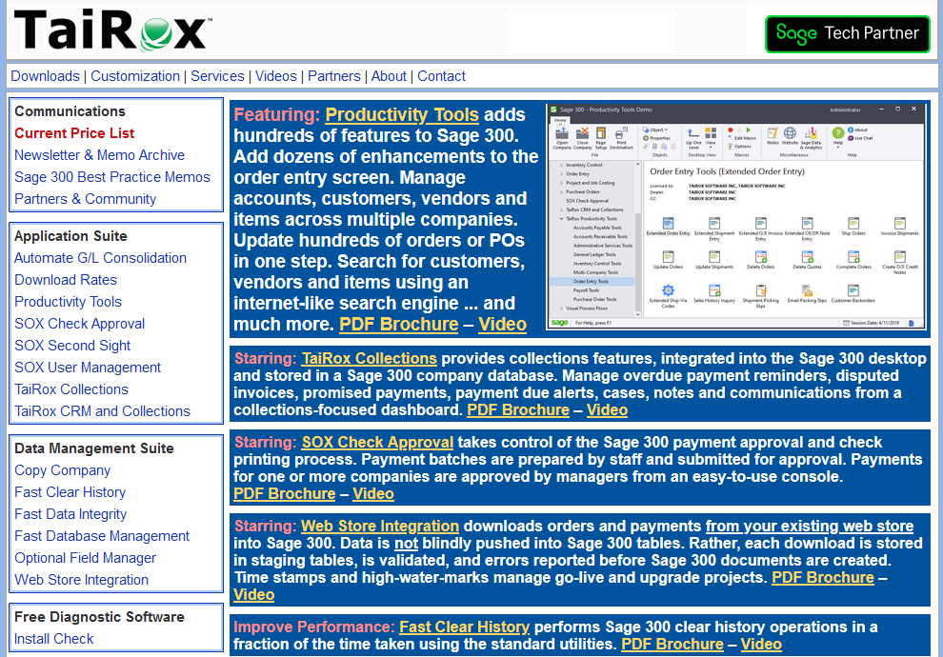
TaiRox Website
Up-to-Date
  Price List
  PDF Brochures
  Videos
  Memos
  Newsletters
  Downloads
  Release Notes
  Install Check

Slide 4
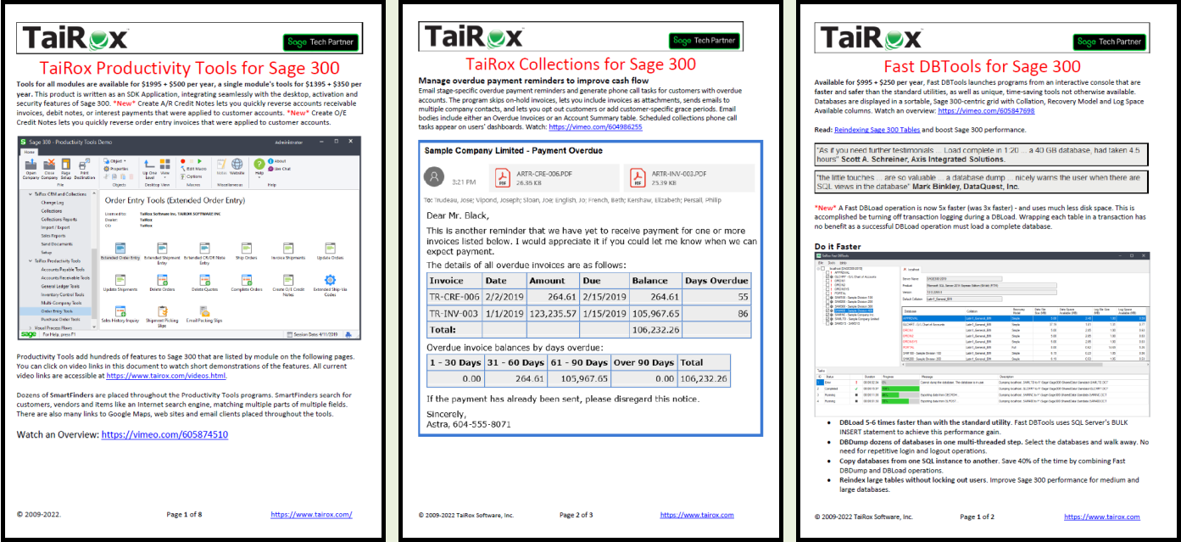
PDF Brochures with Embedded Videos

Slide 5
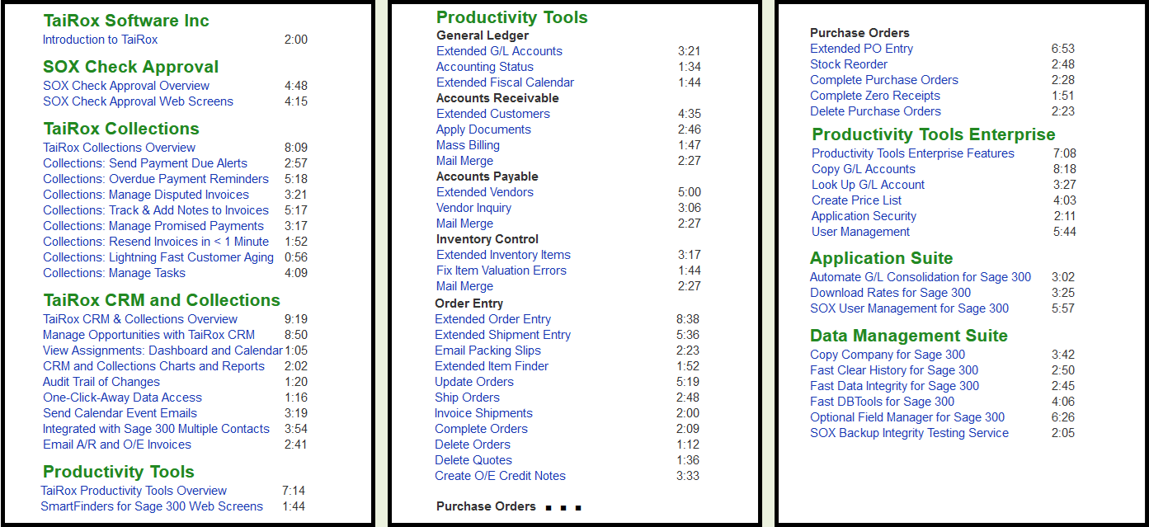
Videos Page

Slide 6
Memos: Sage 300 Technical Details

Slide 7
SOX User Management and 2024 Security
Vault and Store Databases
  ISAM user data is now stored in SQL tables
  Adds a SQL Server user layer
    A SQL Server login, user roles for certain databases
Once set up, how would you migrate?
  Export/Import: passwords are not copied
  Backup/Restore: master database entries!

Slide 8
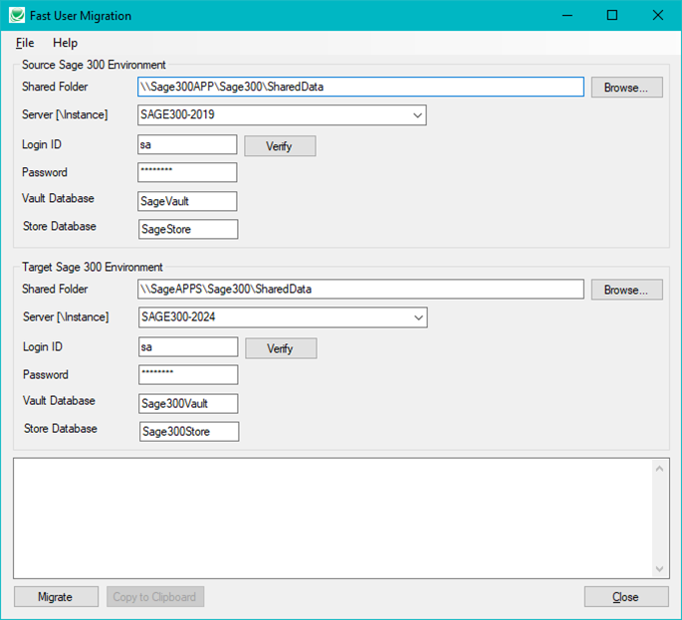
Fast User Migration

Slide 9
Fast User Migration
Migrates all user information from the source databases to the target databases, including passwords and email settings.
Performs INSERTS only on the target databases, so you can migrate new users but cannot update user accounts.
Does not create the ADMIN or GUEST logins in the target environment. These logins are created by Sage 300 when you set up a new Sage 300 environment.
https://vimeo.com/914857964

Slide 10
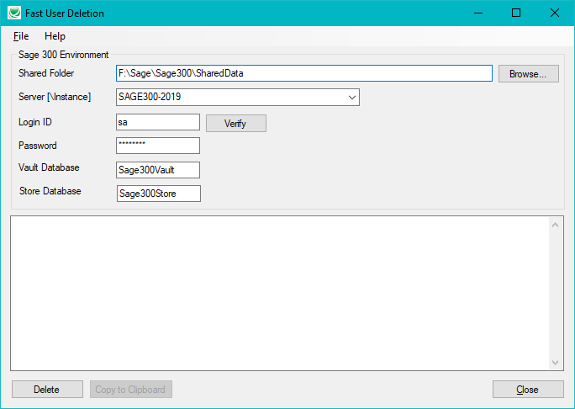
Fast User Deletion

Slide 11
What Is Productivity Tools? 50+ Programs
Extended
  The program “takes over” a Sage 300 UI
Complete, Delete, Update, Ship, Invoice, Apply, etc.
  The program performs hundreds of operations
Inquiry, Status, Look Up
  The program provides improved visibility into data

Slide 12
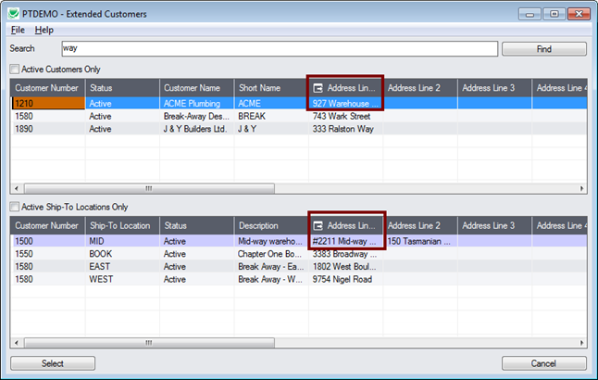
SmartFinders – Like an Internet Search Engine

Slide 13
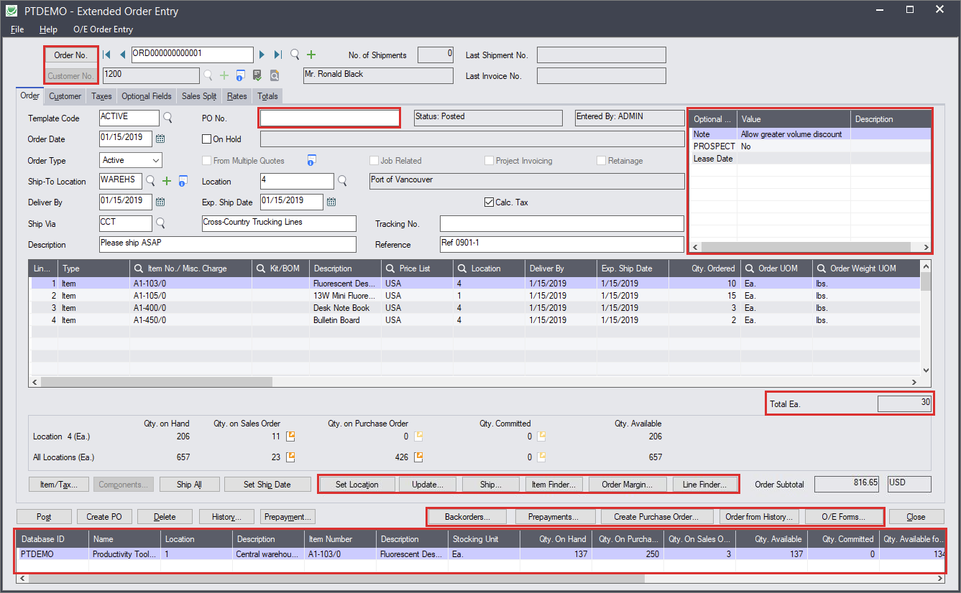
What is Productivity Tools? "Extended"

Slide 14
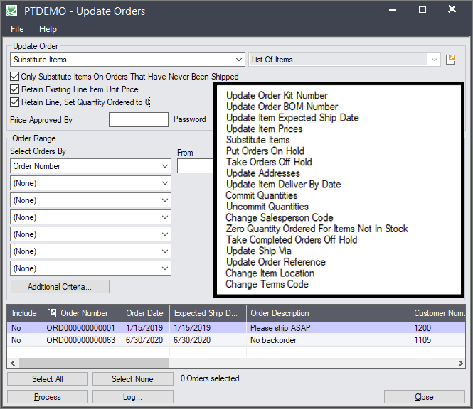
What is Productivity Tools? "Update"

Slide 15
Productivity Tools – 2024 Changes
New Programs
  Update Customers
    Updates a Salesperson code for multiple customers in one step
  Customer Backorders
    Displays active orders for a customer that have backordered items
  Remove Items from Price Lists
Extended Order Entry – new Options
  Force a ship-to address to be entered, Do not allow a ship-to address to be changed
  Add X business days to Expected Ship Date
  Add Y business days to Deliver By date
Update Orders – Terms Codes

Slide 16
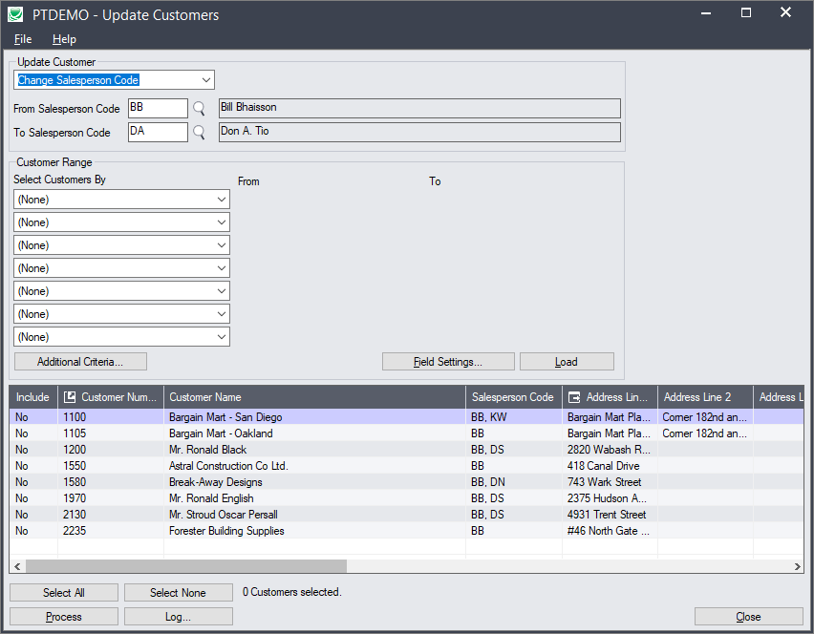
Update Customers
Notes:
A setup and a copying program provide the new functionality. A subscription to Copy Company is included.
click
Unlike many sub-enterprise products, there are no license limitations for users or companies.

Slide 17
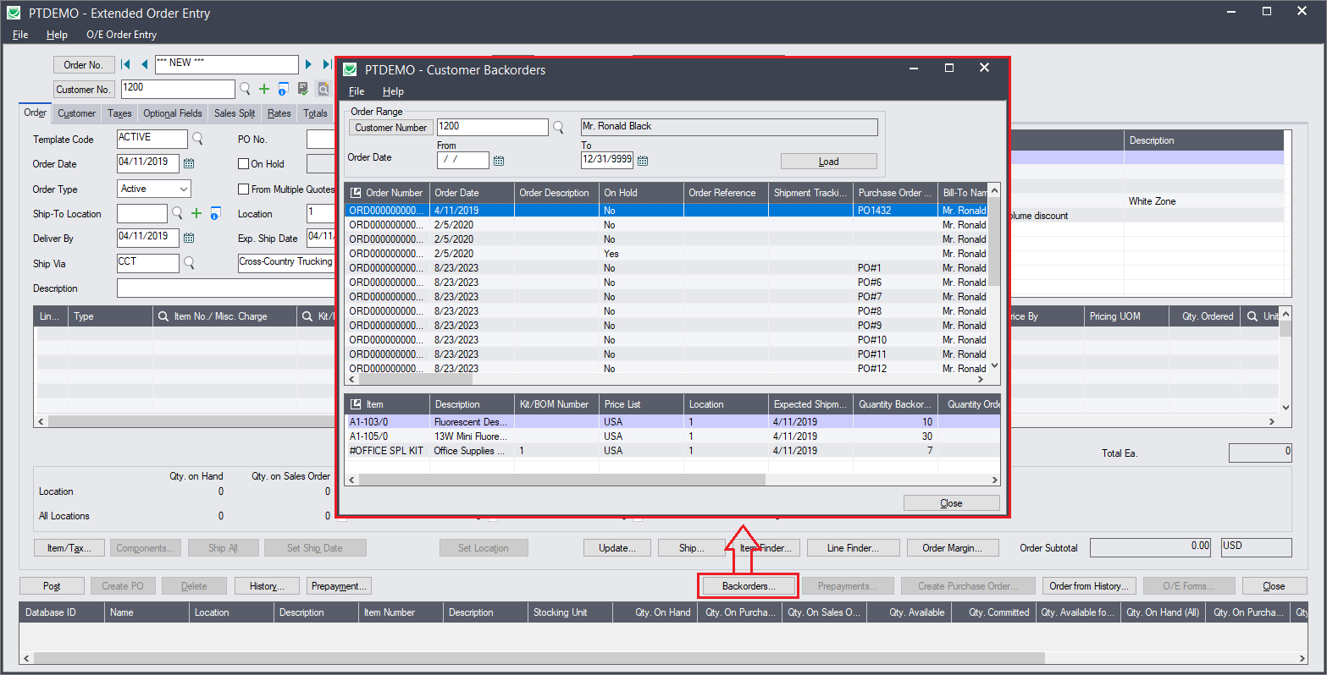
Customer Backorders
Notes:
A setup and a copying program provide the new functionality. A subscription to Copy Company is included.
click
Unlike many sub-enterprise products, there are no license limitations for users or companies.

Slide 18
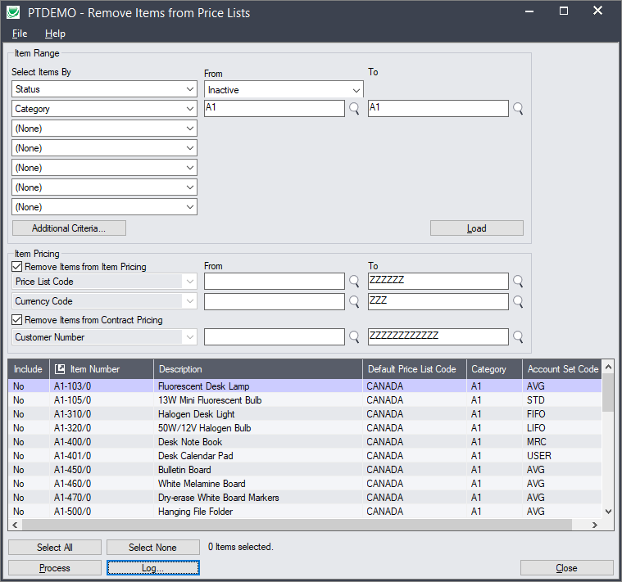
Remove Items From Price Lists
Notes:
A setup and a copying program provide the new functionality. A subscription to Copy Company is included.
click
Unlike many sub-enterprise products, there are no license limitations for users or companies.

Slide 19
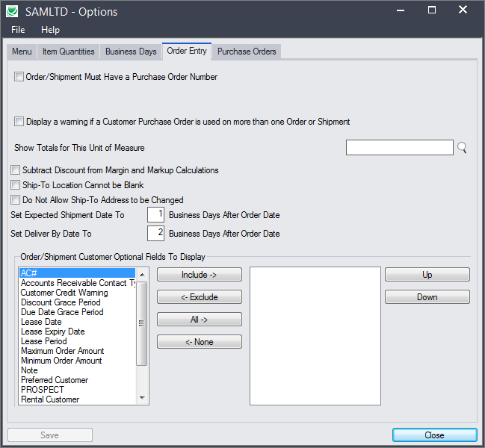
Extended Order Entry Options
Notes:
A setup and a copying program provide the new functionality. A subscription to Copy Company is included.
click
Unlike many sub-enterprise products, there are no license limitations for users or companies.

Slide 20
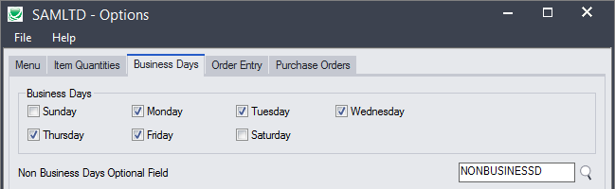
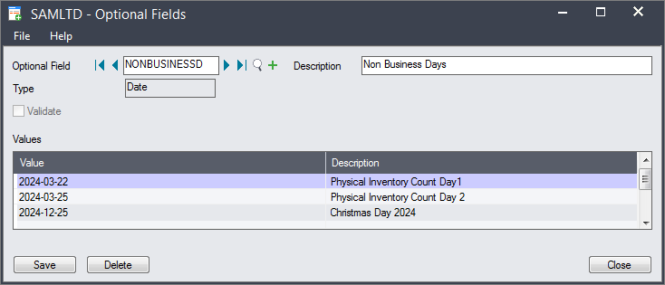
Extended Order Entry Options
Notes:
A setup and a copying program provide the new functionality. A subscription to Copy Company is included.
click
Unlike many sub-enterprise products, there are no license limitations for users or companies.

Slide 21
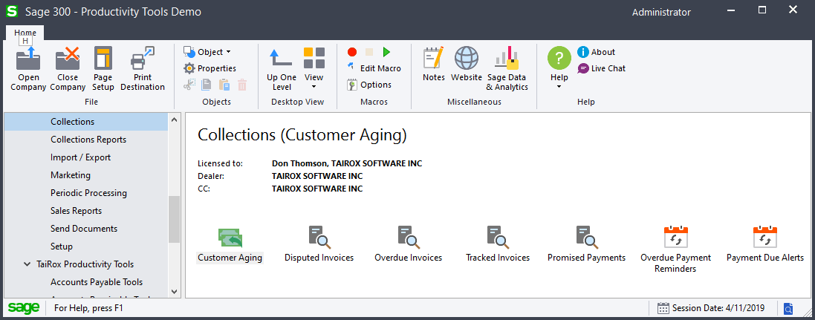
What is TaiRox Collections?
Not Merely Integrated: Embedded!
  Sage 300 Look-and-Feel, Multi-Currency, Multiple Contacts, Multi-Language
  DBDump, DBLoad, Integrity Check, Number Changer, Clear History

Slide 22
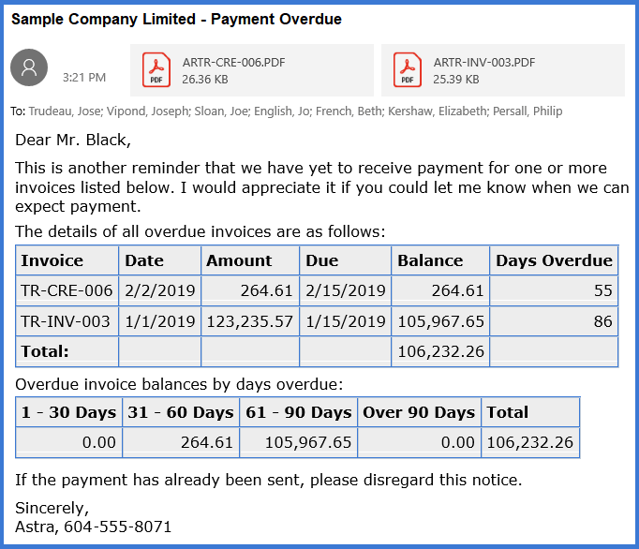
What is TaiRox Collections?
Overdue Payment Reminders
Payment Due Alerts
Invoices

Slide 23
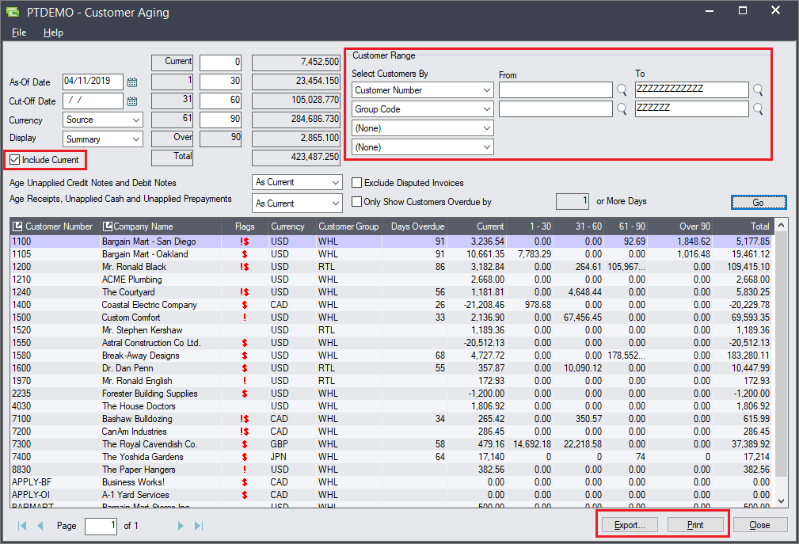
What is TaiRox Collections?
Aged Trial Balance
  Fast
  Enhanced Display
  Filtering Options
  Export to Excel
  Print ATB

Slide 24
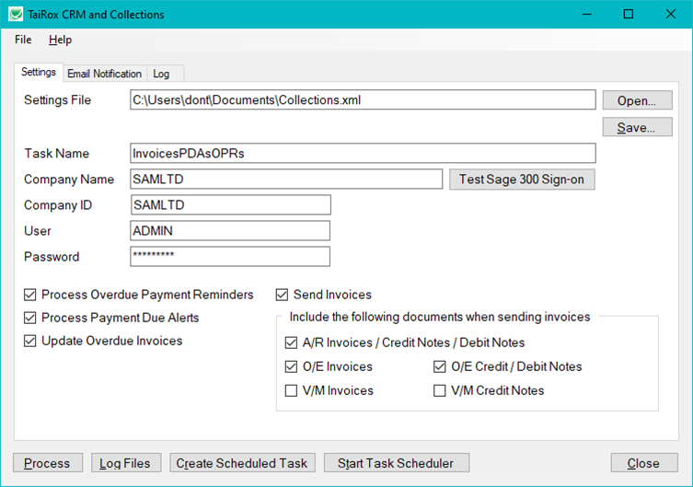
TaiRox Collections – 2024 Changes
Scheduler Program
  A Windows Scheduled Task
  Sends "Unprinted" Documents
    Invoices (AR, OE, VM)
    Debit/Credit Notes (AR, VM)
    Overdue Payment Reminders
    Payment Due Alerts
  Preferred Language Support

Slide 25
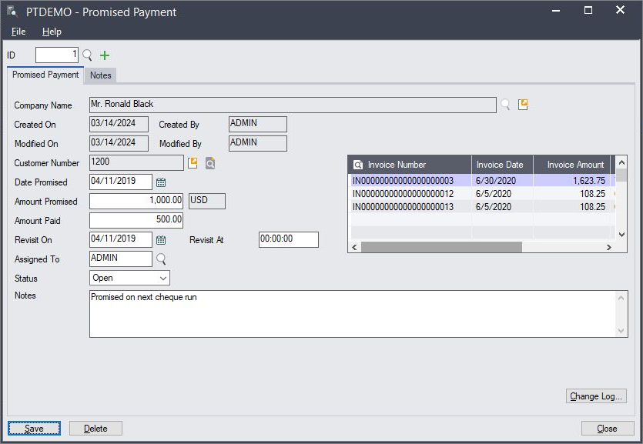
TaiRox Collections – 2024 Changes
Promised Payments
  Can now be linked to multiple invoices

Slide 26
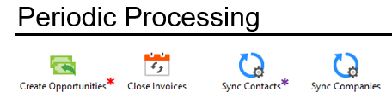

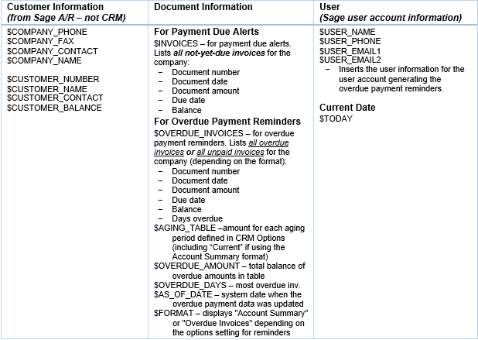
TaiRox Collections – 2024 Changes
Close Invoices
  Closes tracked and disputed invoices that have been paid
French Language
  Customer's Preferred Language
  French OPR, PDA, INV Templates
  Send Documents per Language
Scalability (OPRs, PDAs, Aging)
Additional Template Macros
  CUSTOMER_BALANCE, OVERDUE_AMOUNT
Overdue Payment Reminders Report

Slide 27

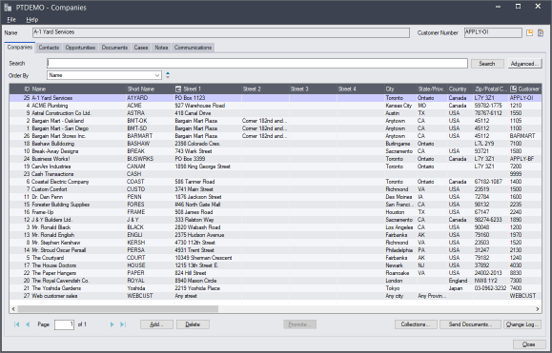
TaiRox CRM & Collections – 2024 Changes
Bulk Mailing
  Local Email Server
  SendGrid
  MailChimp
Merge Contact Groups
Useability
  Dynamic Page Sizes
  Lots More Drag-and-Drop
Dashboard Whole Year Option
Number Changer Combine Support

Slide 28
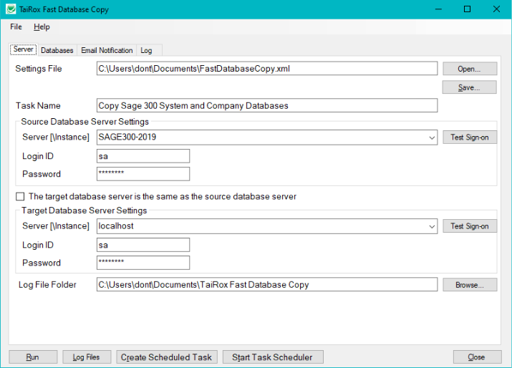
Fast Database Management
Includes 3 Programs:
  Fast DBTools
  SOX Backup Enterprise
    as Fast Database Management
  Fast Database Copy *new*
    4 hours to 16 minutes

Slide 29
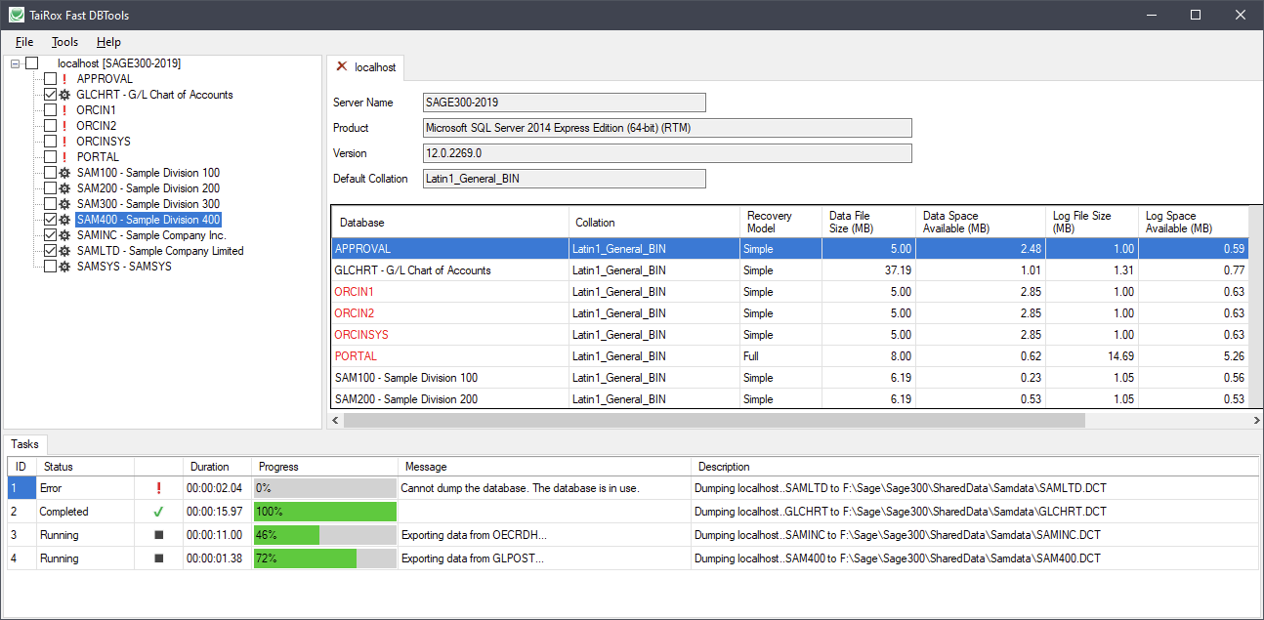
Fast DBTools – 2023 Changes
DBLoad
  Now 5x-6x faster
  (no transactions)
Passwords
Re-indexing

Slide 30
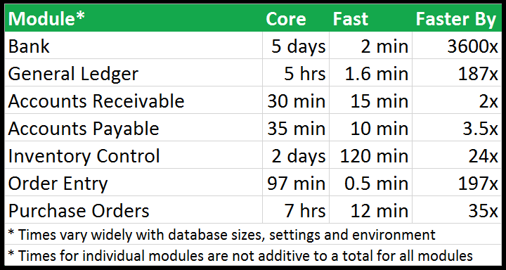
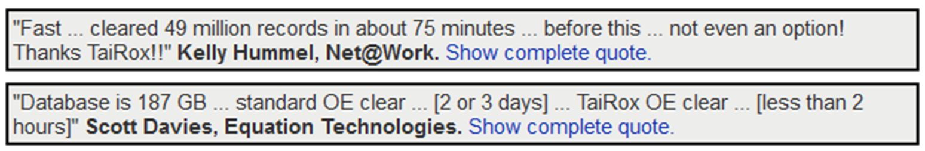
Fast Clear History – 2023 Changes
Clears More
  AR/AP Tax Withholding
  AR/AP Deleted Batches
  Clears Collections & CRM
Options
  OE Use Transaction Date
    Instead of Completion Date
Passwords

Slide 31
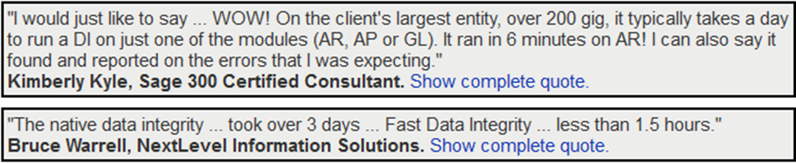
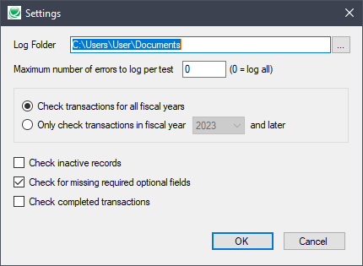
Fast Data Integrity – 2023 Changes
Checks More
  Recent PJC Versions
  Productivity Tools Enterprise
  TaiRox Collections & CRM
Checks Less
  Inactive Records
  Completed Transactions
  Required Optional Fields
Passwords

Slide 32
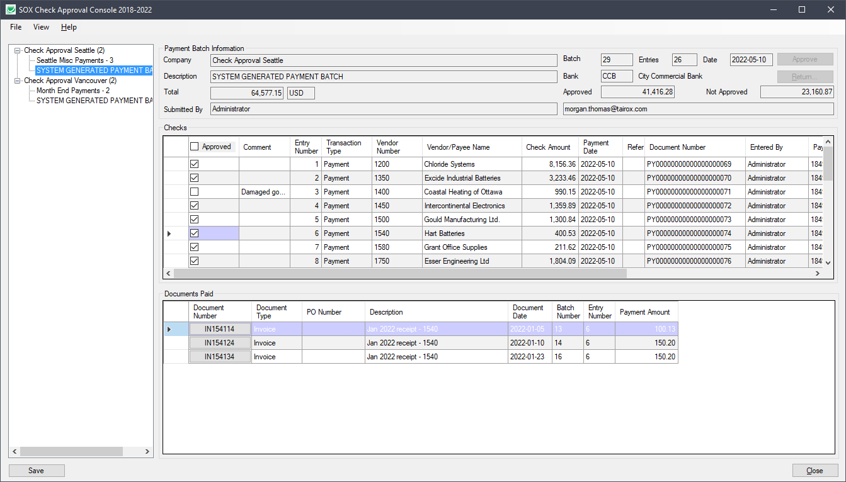
SOX Check Approval
4 Workflows
  Strict
  Basic
  Relaxed
  Simplified
Hybrid Workflows
Web Screens

Slide 33
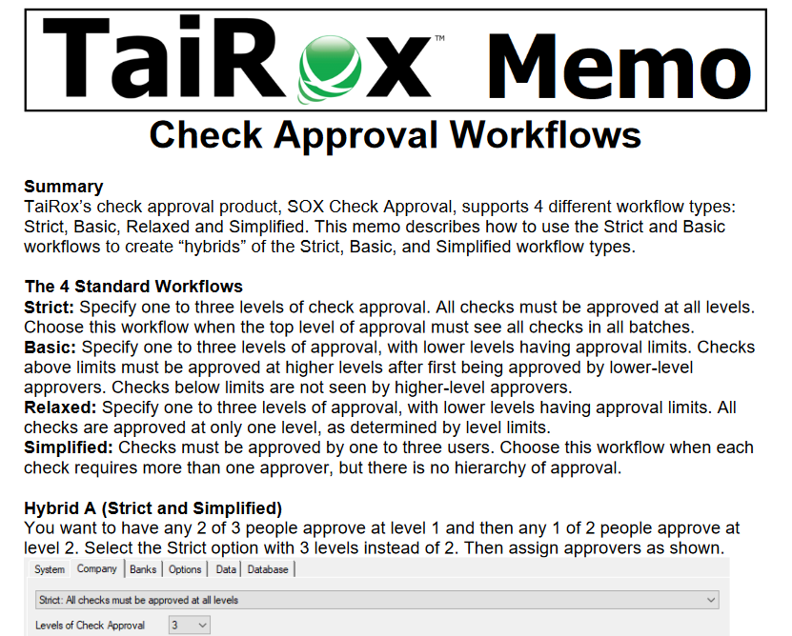
SOX Check Approval
Hybrid Workflows

Slide 34
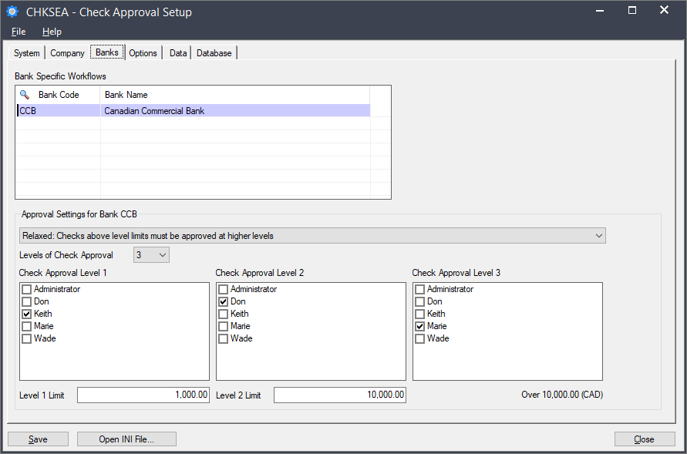
SOX Check Approval Enterprise
Workflows Per Bank

Slide 35
What’s New
TaiRox Website Resources
What's New
  SOX User Management and 2024 Security
  Productivity Tools
  TaiRox Collections
  Fast Products
    New: Fast Database Management, Fast Database Copy
  SOX Check Approval

