Slide 1

Why Sage 300?
Don Thomson and Doug Ash

Slide 2
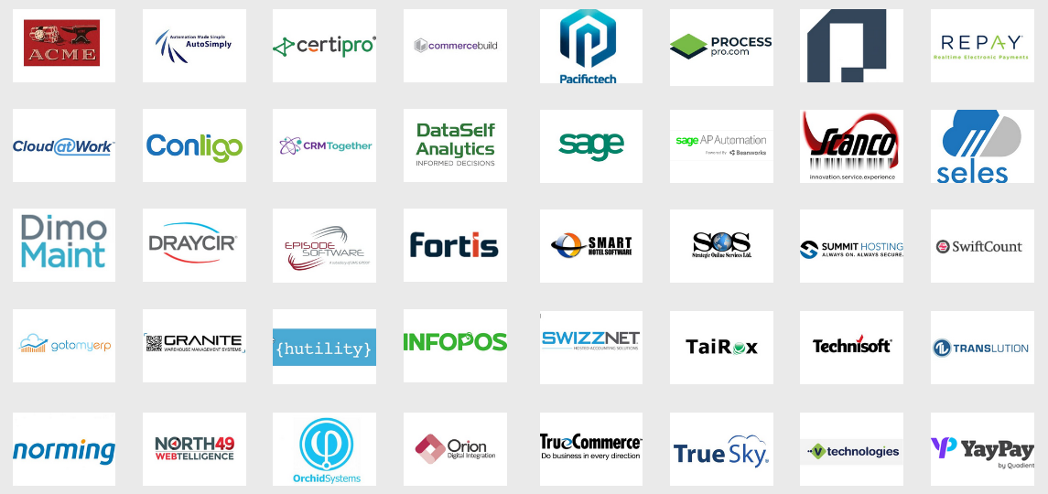
Third Party Software

Slide 3



Context: The Mid-Market
Stability
vs.
Innovation

Slide 4
Accounting Software Evolution
An Accounting Package Finds a Niche
Existing Customers Grow
More Features, More Options are Added
A Complete Mid-Market Offering takes 10 years!
Lo-Mid-Market: More Integration with External Systems
Hi-Mid-Market: Automation

Slide 5
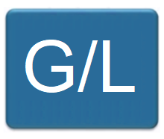
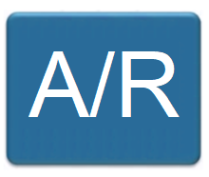
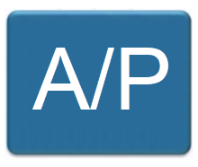
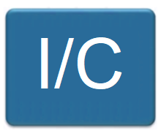
Accounting Evolution

Slide 6
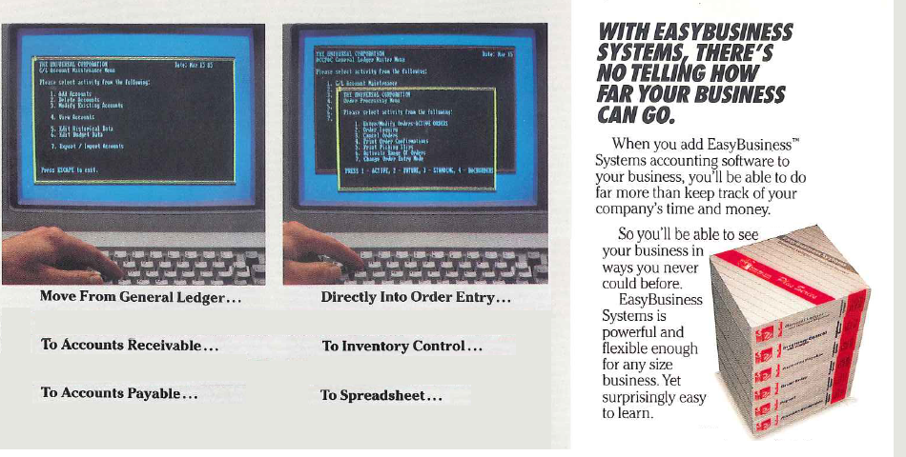
Accounting Evolution

Slide 7
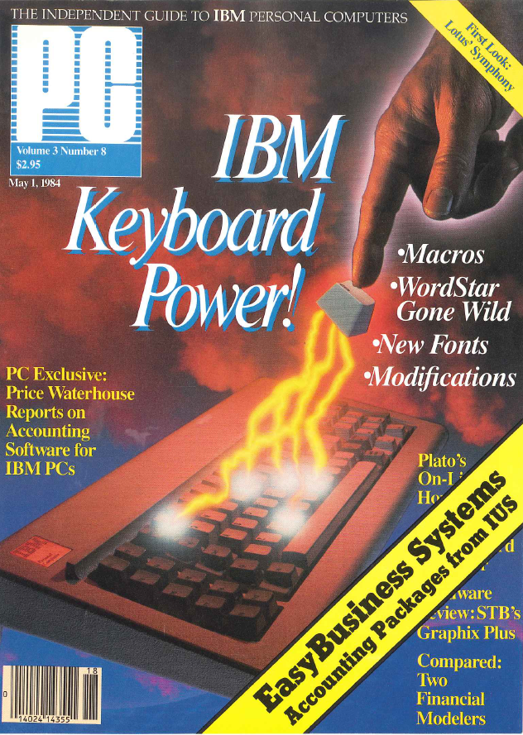
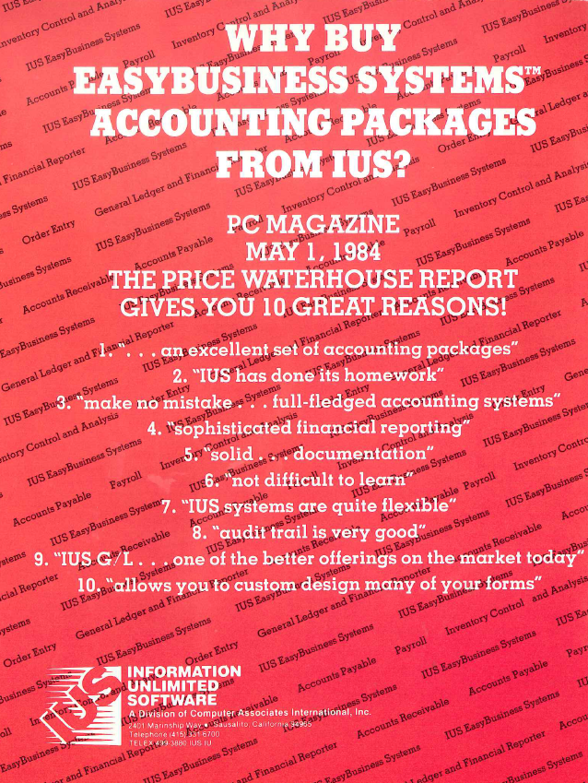
Accounting Evolution

Slide 8
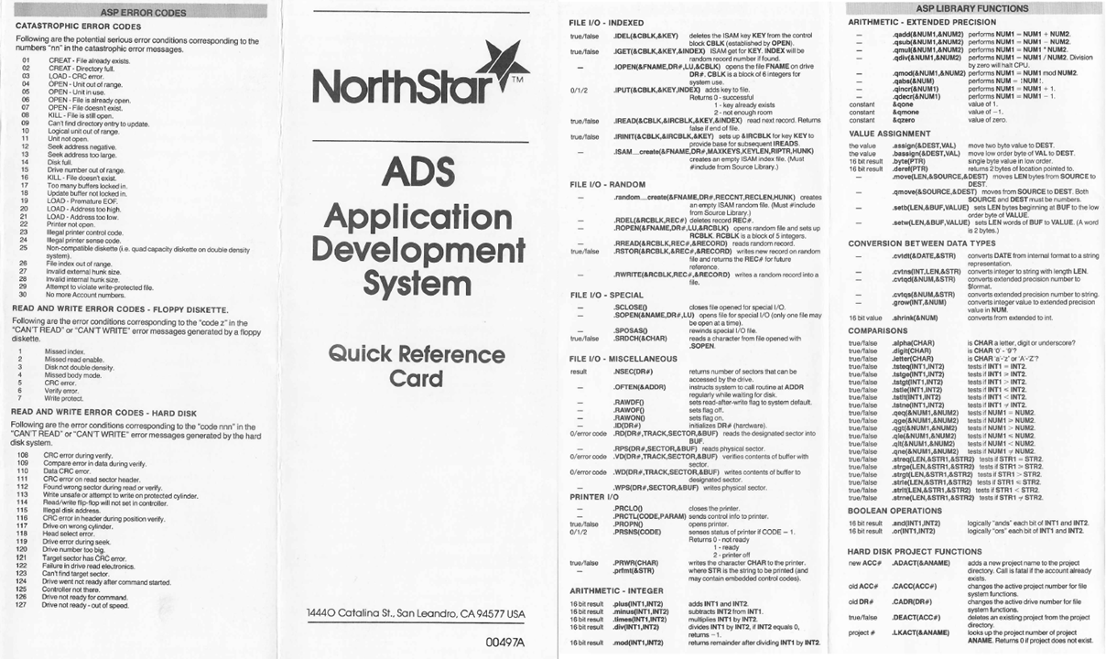
Accounting Evolution

Slide 9
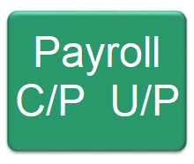
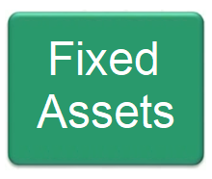

Accounting Evolution
Manufacturing, Warehouse, Point-of-Sale, Payments, Document Mgmt., Web Stores, Analytics, Hotel Mgmt., …

Slide 10
Sage 300 Core Strengths
Multi-Language
Multi-Currency
Data Entry Speed
Embedded US and Canadian Payroll
Multi-Segmented G/L Account Structures
Costing Methods, Serial Numbers, Lots
Payment Schedules, Recurring Entries, Batch Orientation, and so on

Slide 11
Sage 300 Customization Strengths
Embedded, using API
  Third Party Modules
    Finders
    Optional Fields
    User Settings
  Embedded Integrations
  Subclassed API Objects
Macros
Import / Export

Slide 12
Sage 300 Deployment Strengths
On Premise Control
  Data - Backup/Restore Strategy
  Compliance - Security
  Deployment - Testing, Versions, Third Parties
  Integration – Software and Hardware
Run in a Browser (via VPN, Published Services)
Connect to Cloud Services
Web Services (with limitations)

Slide 13


Stability vs. Innovation

Slide 14
Third Party Software

Slide 15

Why Sage 300

