Slide 1

What’s New at TaiRox
Don Thomson, CEO

Slide 2
What’s New at TaiRox
New Features
New Products
  Fast Clear History
  Optional Field Manager
Theme: Support
Theme: Evolving Business Model

Slide 3
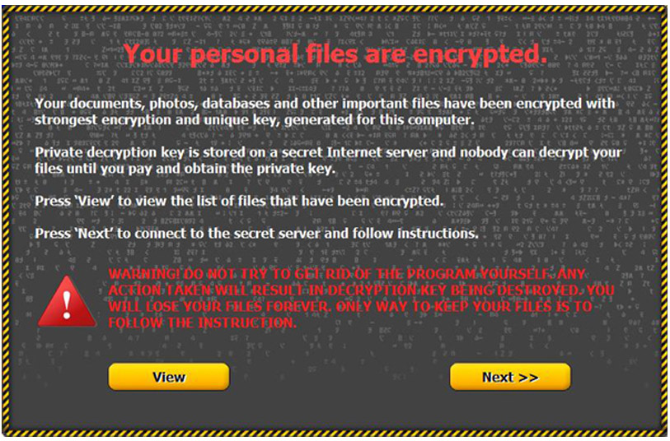
Ransomware

Slide 4
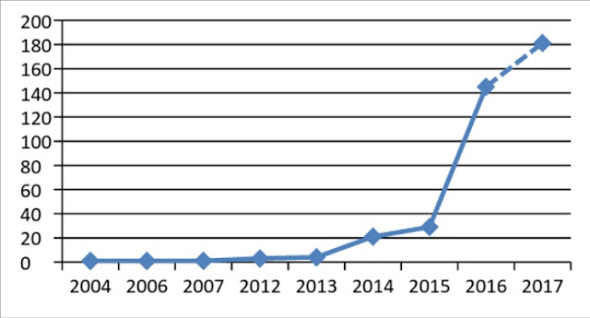
Ransomware
851% growth in the number of ransomware families in 9 months … ransomware as a service

Slide 5
Ransomware
1-2% of Sage 300 companies are infected every month!
Source: Anecdotal

Slide 6
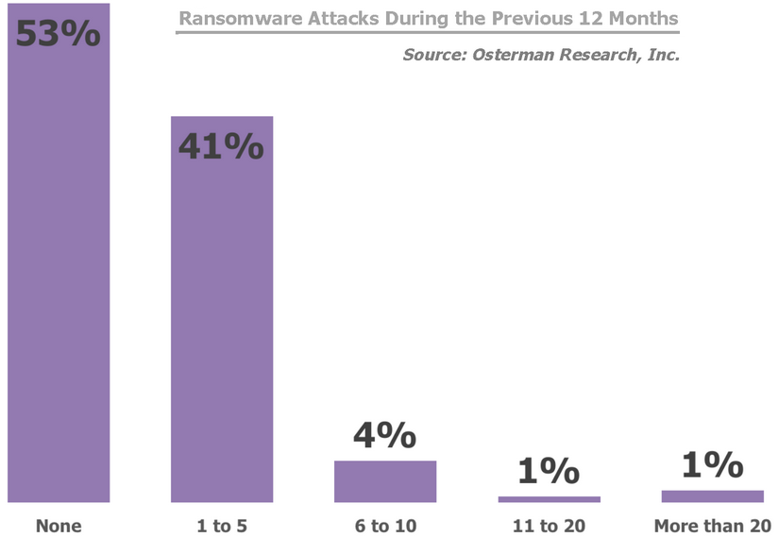
Ransomware

Slide 7
Ransomware Affects Us
Increasingly Complex Windows Security
Increasingly Aggressive Anti-Malware Programs

Slide 8
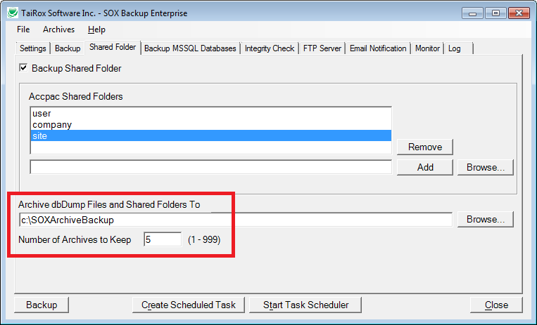
SOX Backup - Protection

Slide 9
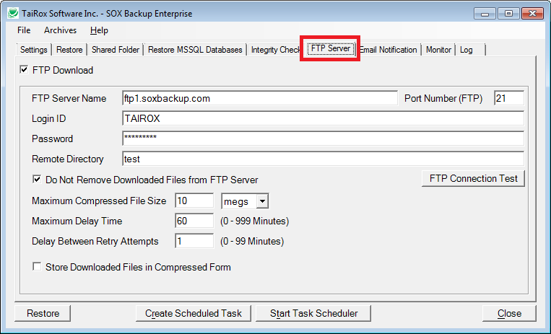
SOX Backup - Protection

Slide 10
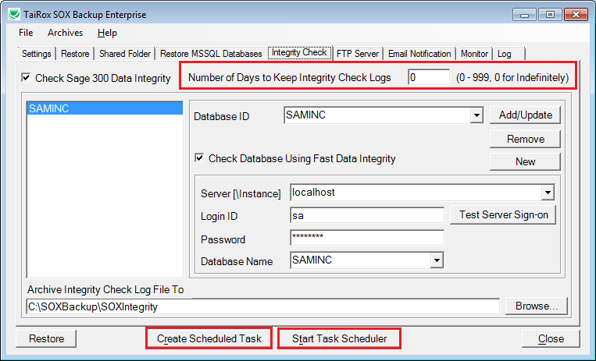
SOX Backup – New Features

Slide 11
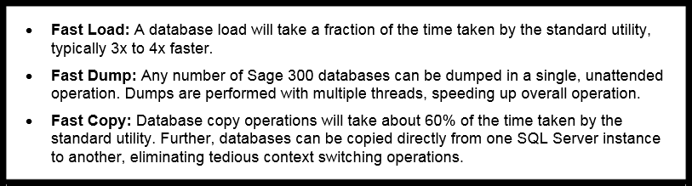
Fast DBTools: Fast!

Slide 12
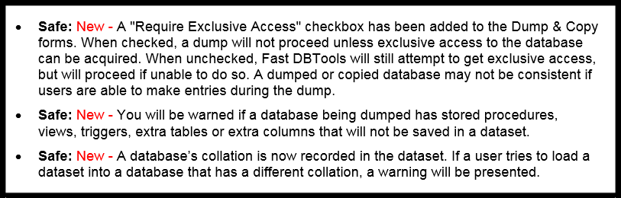
Fast DBTools: Safe!

Slide 13
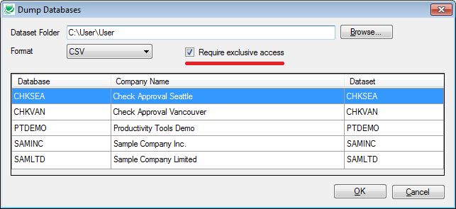
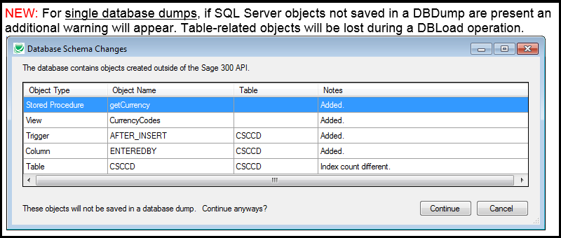
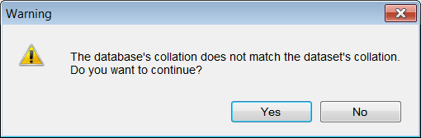
Fast DBTools: Safe!

Slide 14
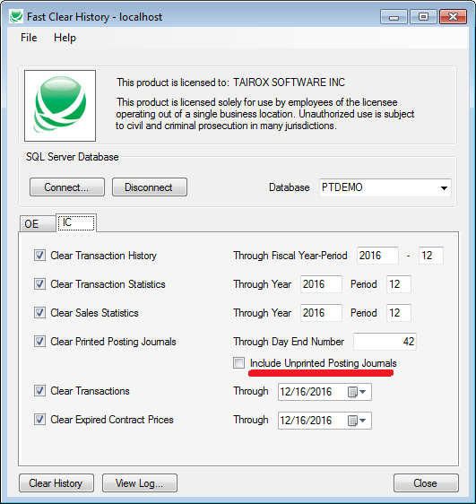
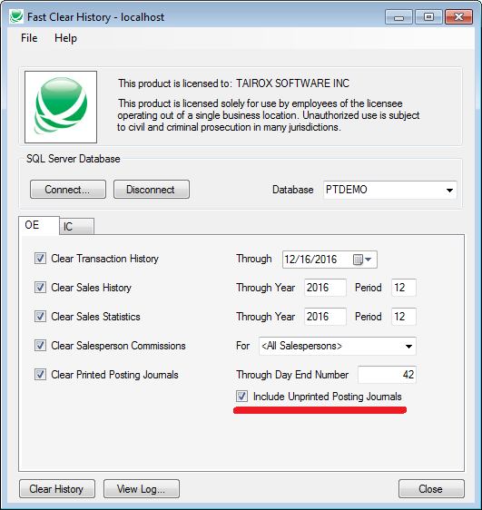
Fast Clear History

Slide 15
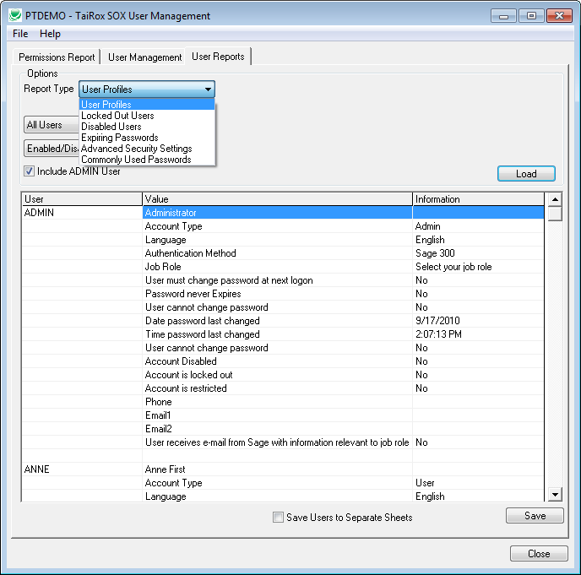
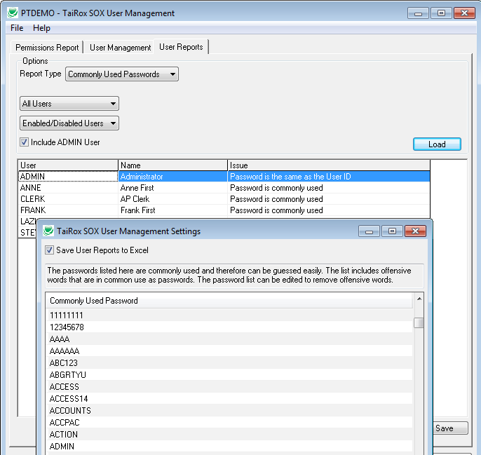
SOX User Management

Slide 16
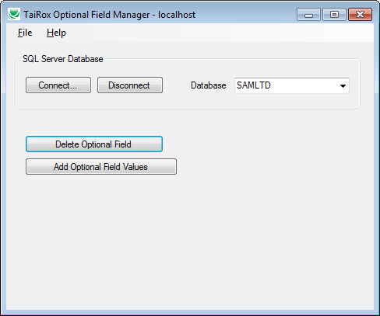
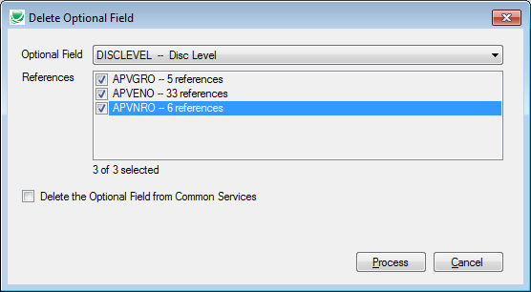
Optional Field Manager

Slide 17
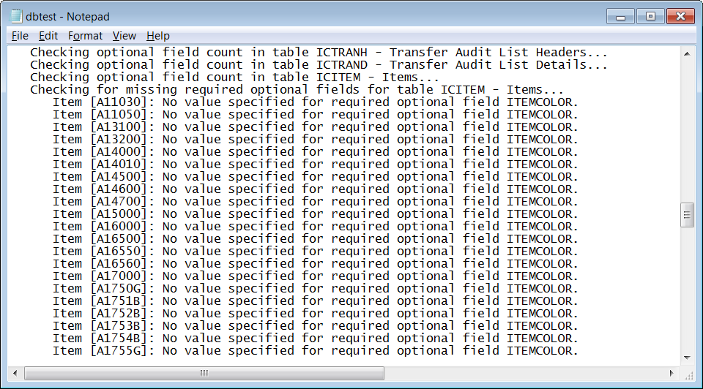
Fast Data Integrity – New Checks

Slide 18
Productivity Tools
What’s New

Slide 19
Productivity Tools – Tiny Features
An option to copy comments and instructions when creating orders and purchase orders from history
Complete Orders will now complete orders with zero lines (even though Sage 300 won’t)
Invoice Shipments will now consolidate invoices by customer or by customer by date

Slide 20
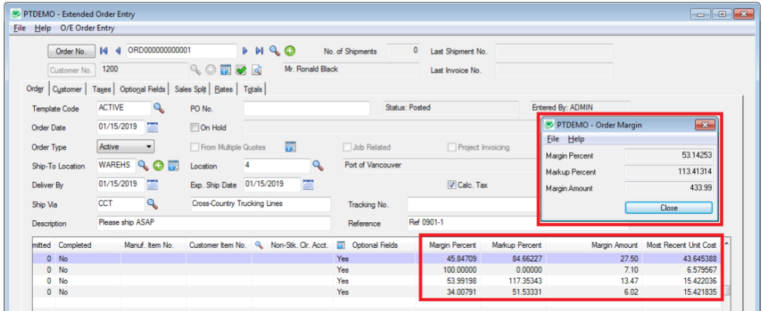
Productivity Tools – Small Features

Slide 21
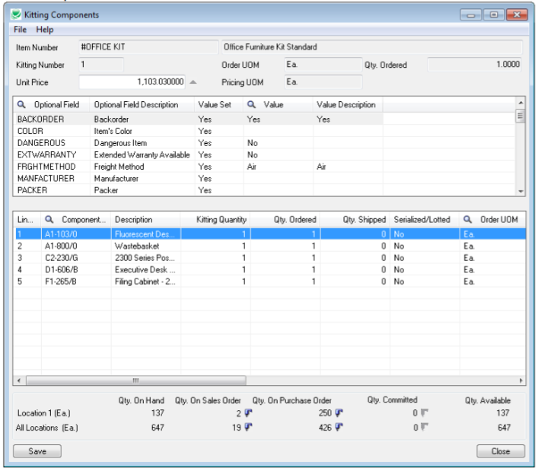
Productivity Tools – Funded Features

Slide 22
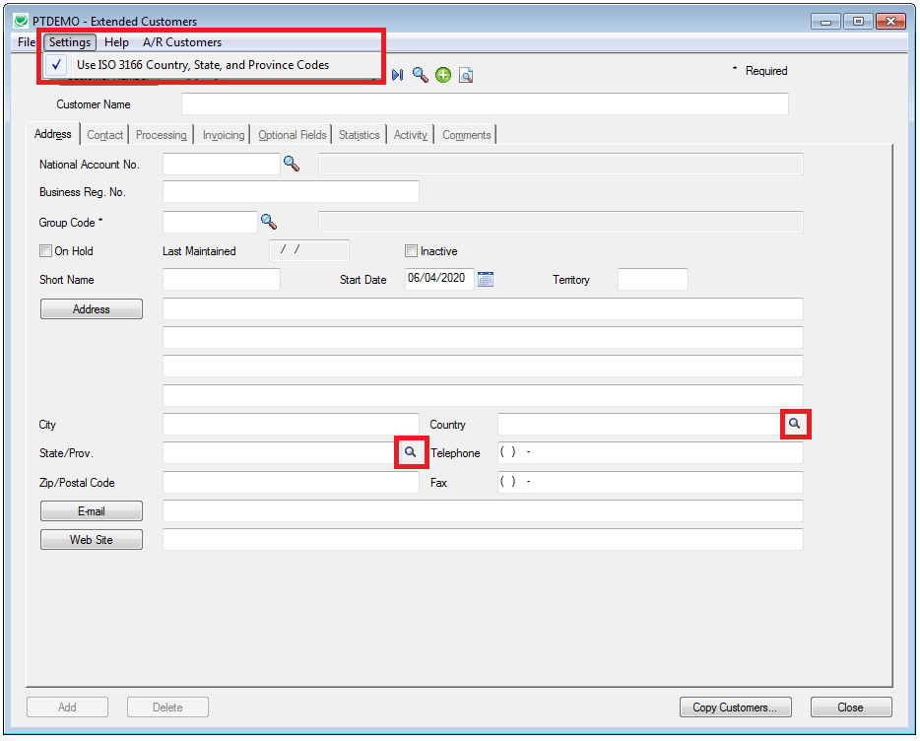
Productivity Tools – Funded Features

Slide 23

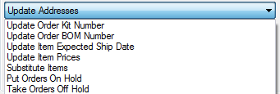

Productivity Tools – Reasons People Buy
Ship Orders
Update Orders
Invoice Shipments
Multi-Company Copying

Slide 24
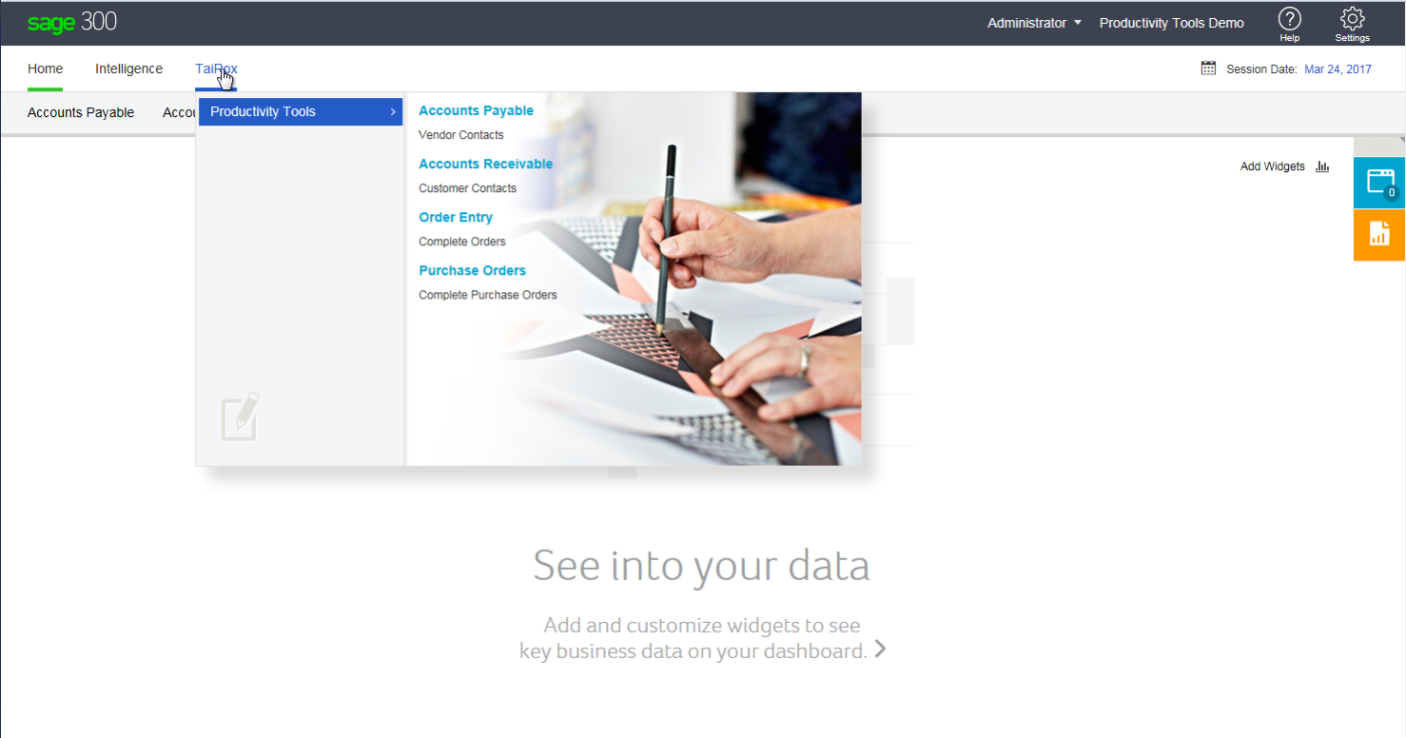
Productivity Tools – 300c

Slide 25
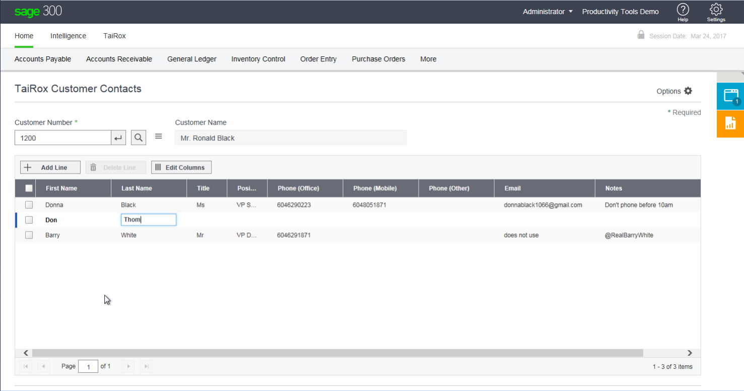
Productivity Tools – 300c

Slide 26
SUPPORT!

Slide 27
Ransomware Affects Us
Increasingly Complex Windows Security
Increasingly Aggressive Anti-Malware Programs

Slide 28
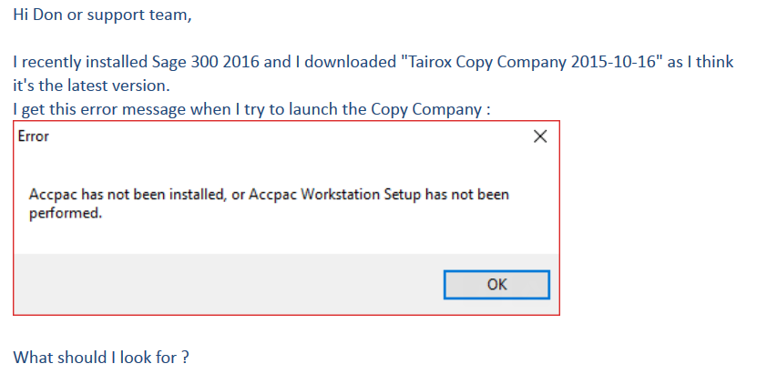
Support Issues

Slide 29
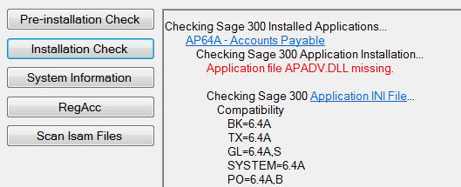
Support Issues
Problem: Sage 300 hangs or crashes, sometimes
Cause: Overly aggressive anti-malware program has quarantined APADV.DLL

Slide 30
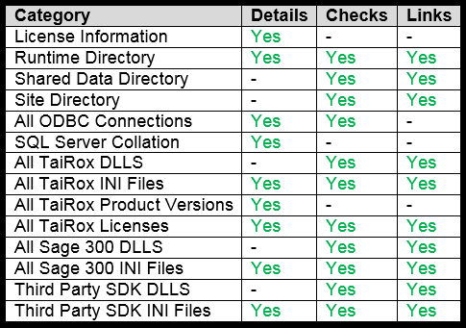
Install Check

